Slide 1

Analysing Car Sales
Of Various Car
Companies Present In Market.
SUBMITTED BY – Akshat Saxena
Ajay Kumar Mathur
SUBMITTED TO - Mr. Ravi Kumar

Slide 2
Outline:
1.Problem Statement
2.Objective
3.Motivation
4.Dataset Description
5.Preprocessing of Data
6.Data Visualization
7.Machine learning Model
8.GUI(Tkinter) Interface

Slide 3
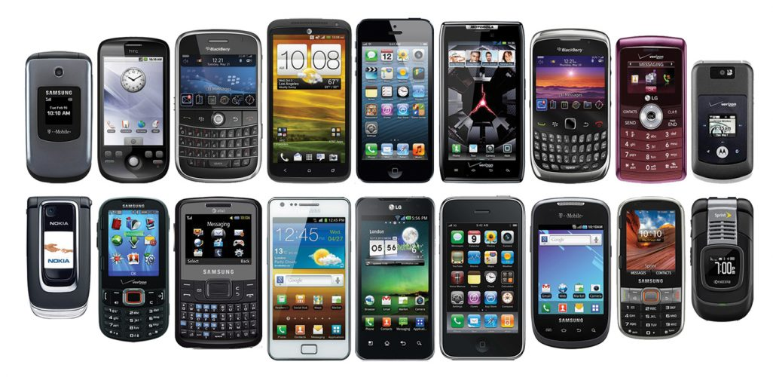
1.Problem Statement
To estimate the price of the car the company creates so that the company can survive in the competitive market. We want to predict a price range indicating how high the price is.
Car price will be predicted on the basis of mobile features such as body type, engine type , wheel type etc.

Slide 4

2. Objective
In Today’s competitive market, we want our company should be able to beat other’s company.
We have to visualize the dataset on the basis of features and type of cars to predict the price range. So that the customers can purchase affordable cars.
Machine will predict car range by analysing the data. .

Slide 5
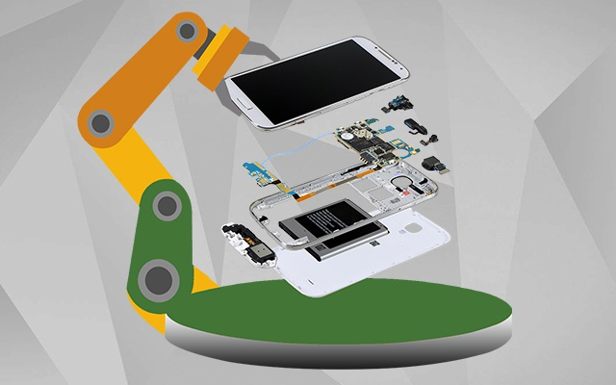
3.Motivation
The motivation for this project comes from seeing the increasing scope in the field of manufacturing cars, as cars have become a necessity in today’s world.
Also on seeing other companies which have already analysed dataset and sold their product more than us and are continuing to make huge profits inspire to work on the dataset collected.
Considering the above, we have collected dataset.
We will implement machine
algorithm which will recommended us what specifications are required in the market.

Slide 6
Dataset Description:
This dataset is taken from Kaggle and is of 2016.
Dataset contains 9576 rows and 10 columns :
car: manufacturer brand
price: seller’s price in advertisement (in USD)
body: car body type
mileage: as mentioned in advertisement .
engV: rounded engine volume (cubic cm)
engType: type of fuel.
registration: whether car registered in Ukraine or not
year: year of production
model: specific model name
drive: drive type

Slide 7
Approach Taken:
First we analyze the sales of various companies available in the market.
Then, we take into account the analyses of only leading brands in the market.
Finally we analyse the most successful company in the market Volkswagen.

Slide 8
Overview:
Sales of various companies and average selling price of various companies.
Sales of car by engine type and body type.
Total sales in the market by drive type of cars.
Analysis of total registered car by engine types.
Market share of cars by fuel type, body type and drive type.
Year wise growth of various companies to analyze the most successful growth rate .
Comparison of top brands on various attributes like average selling price, mileage , drive type and engine type.
Studying growth trend in most successful company in the market which is Volkswagen.
Studying sales of various models of Volkswagen to compete better.
Seeing the trend in sales of Volkswagen on basis of engine type and drive type.
Analysis of Volkswagen models on basis of engine volume and body type.

Slide 9
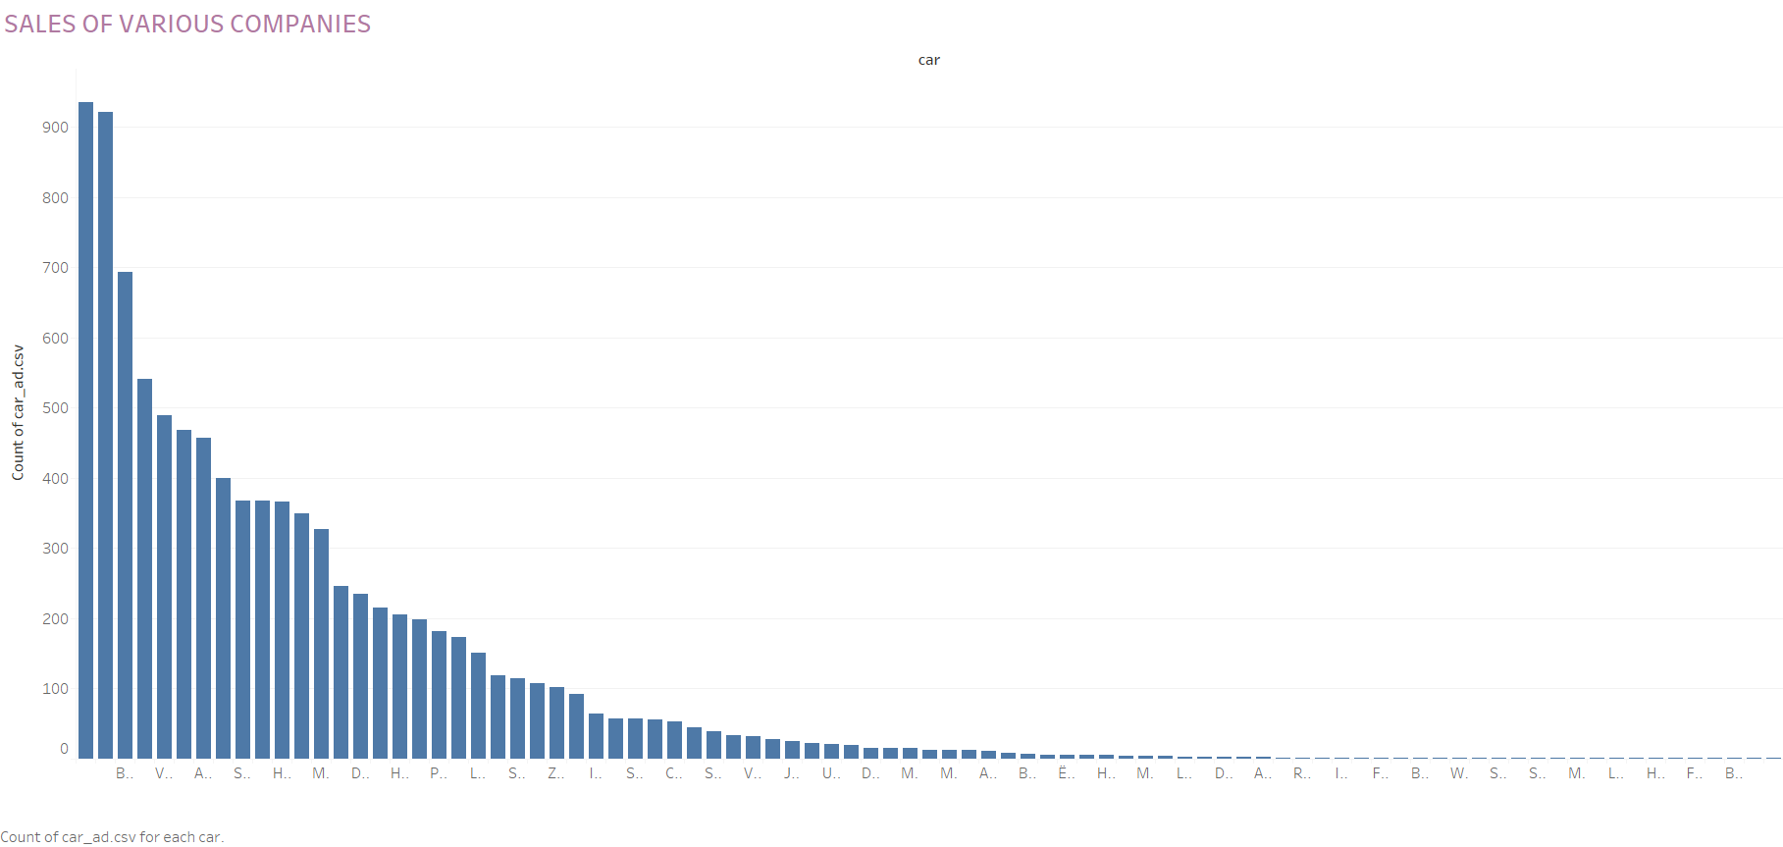
This graph shows the sales of various companies in the market.
From the graph it is clear that Volkswagen stands out as the highest selling brand in the Ukraine market

Slide 10
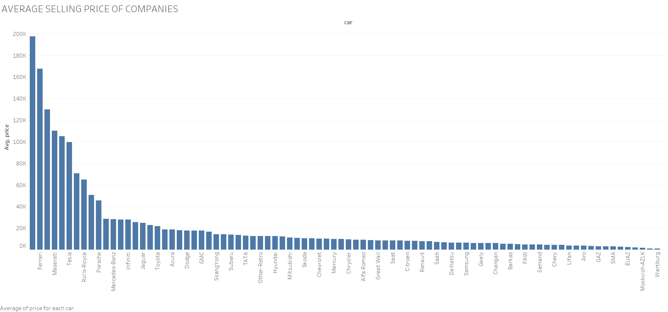

Slide 11
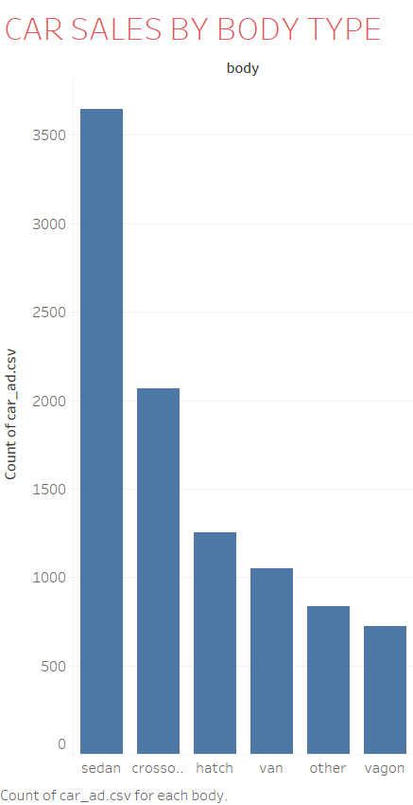

Slide 12
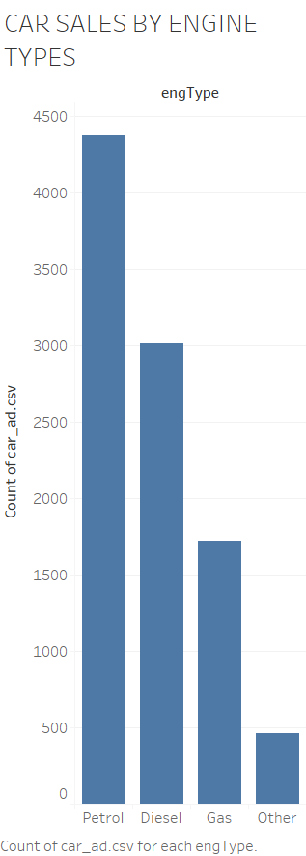

Slide 13
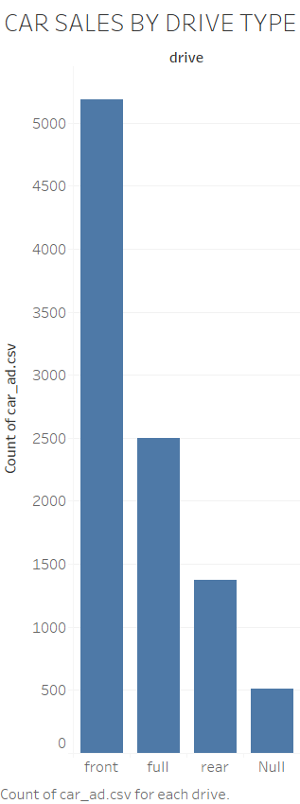

Slide 14
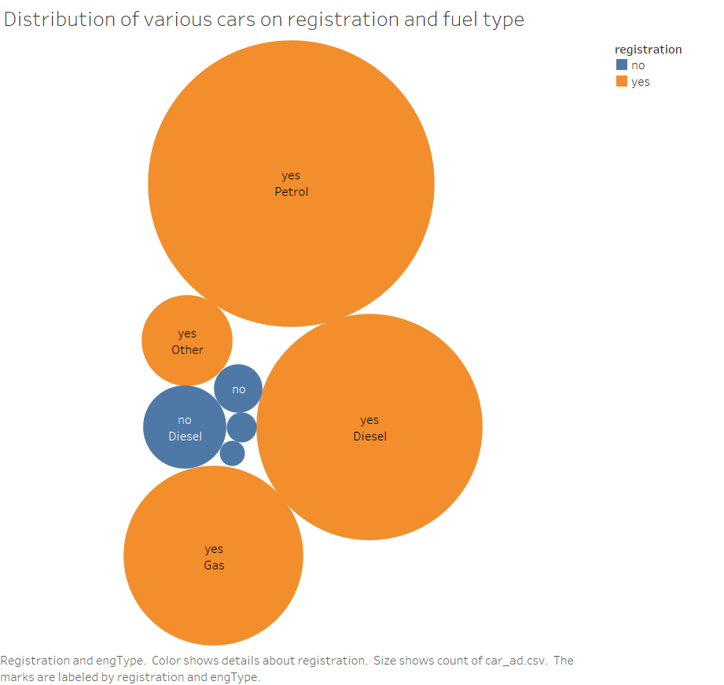

Slide 15
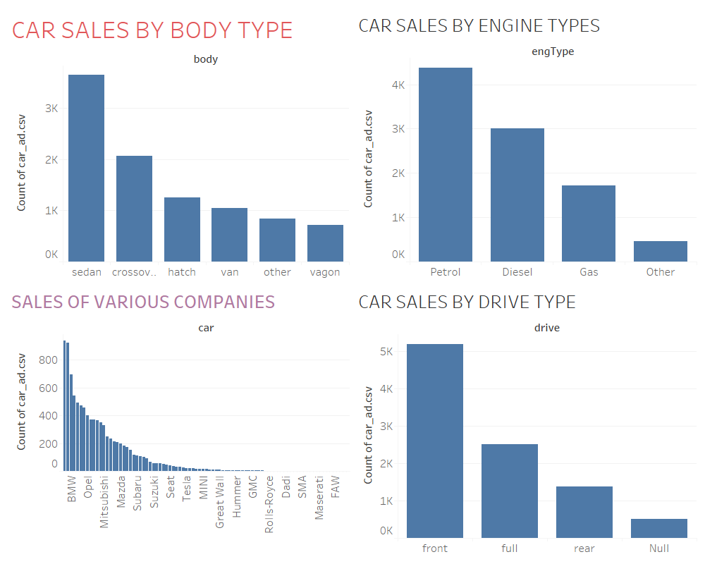

Slide 16
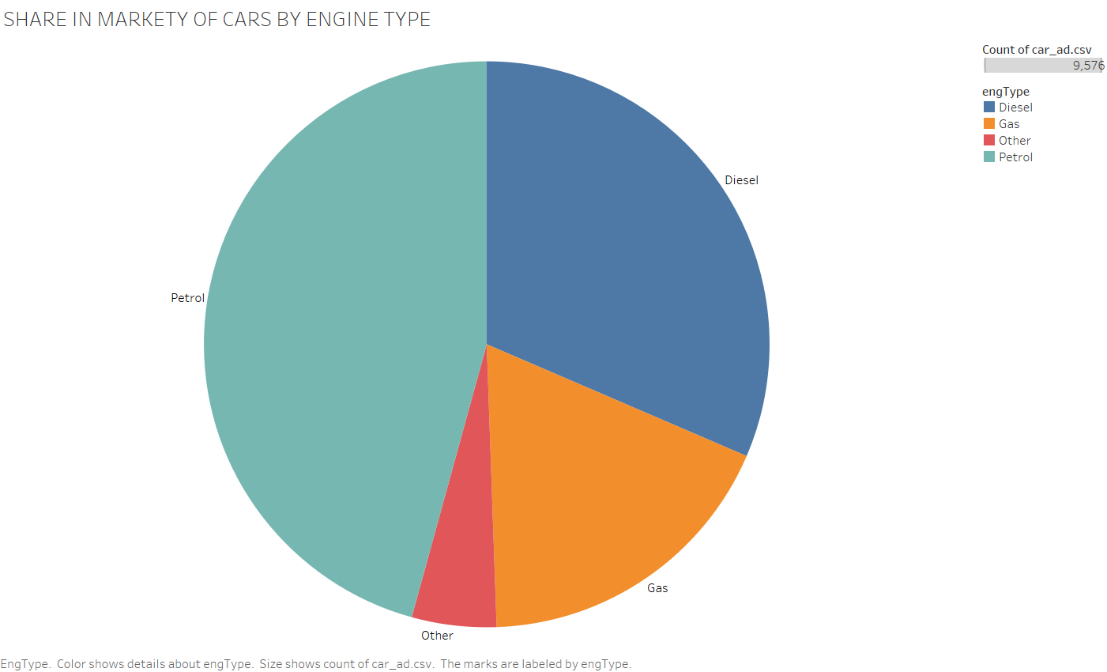

Slide 17
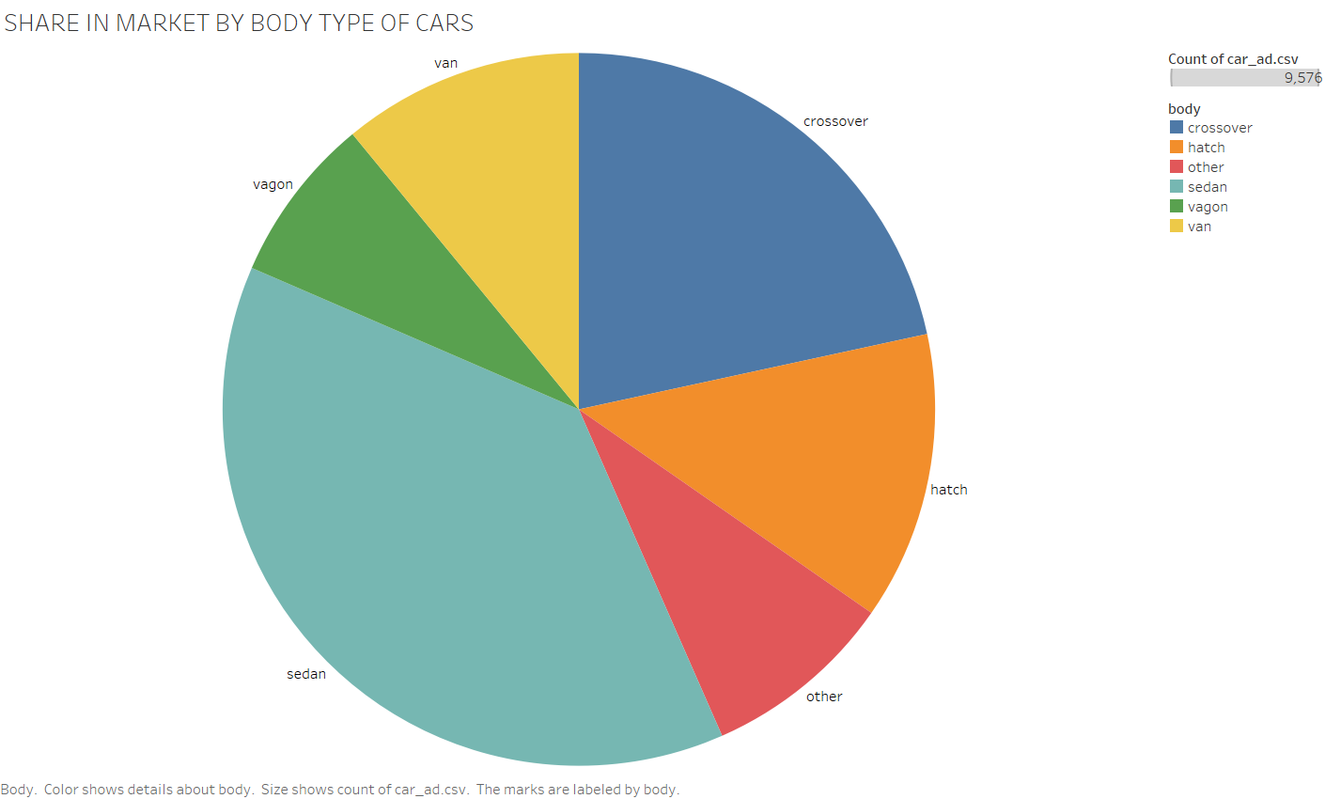

Slide 18
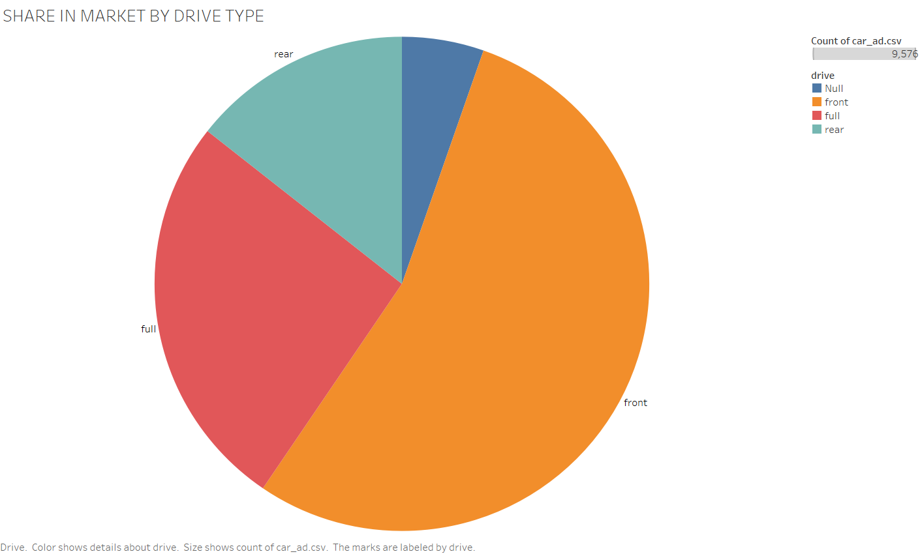

Slide 19
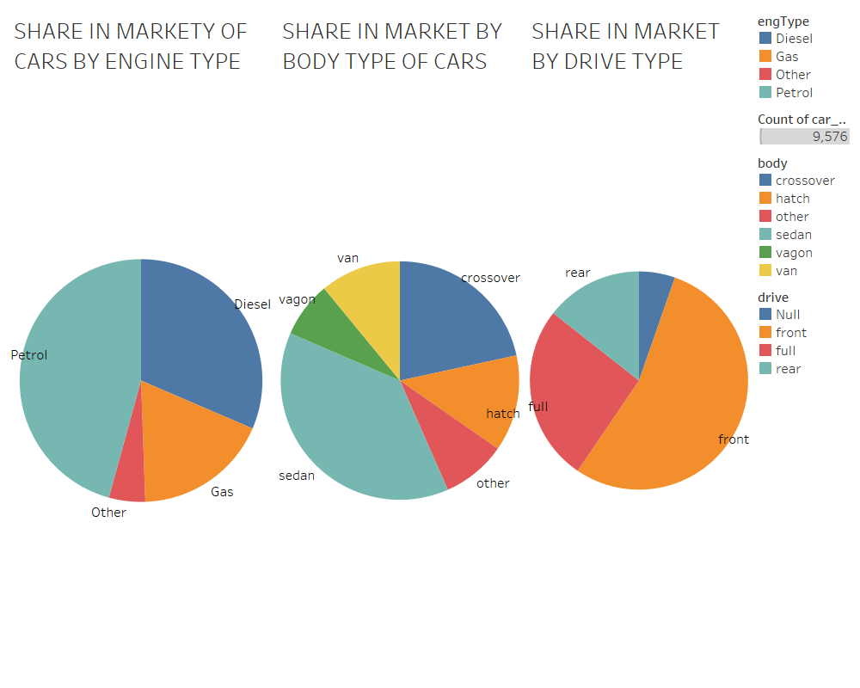

Slide 20
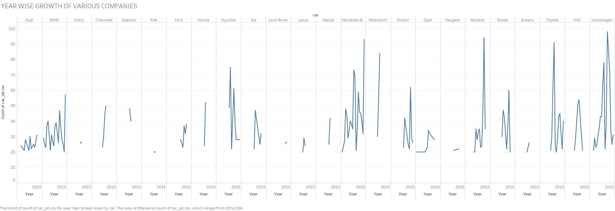

Slide 21
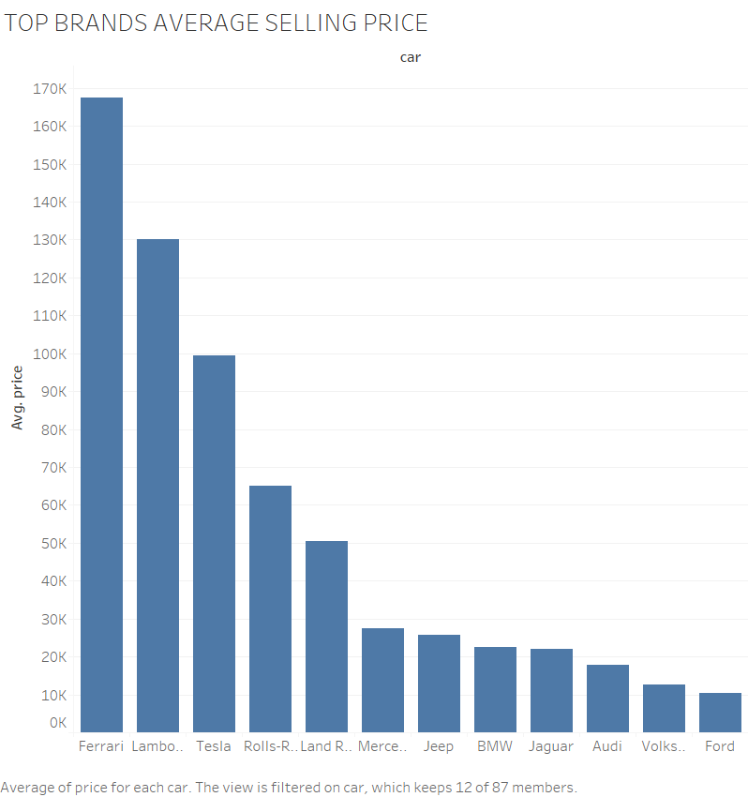

Slide 22
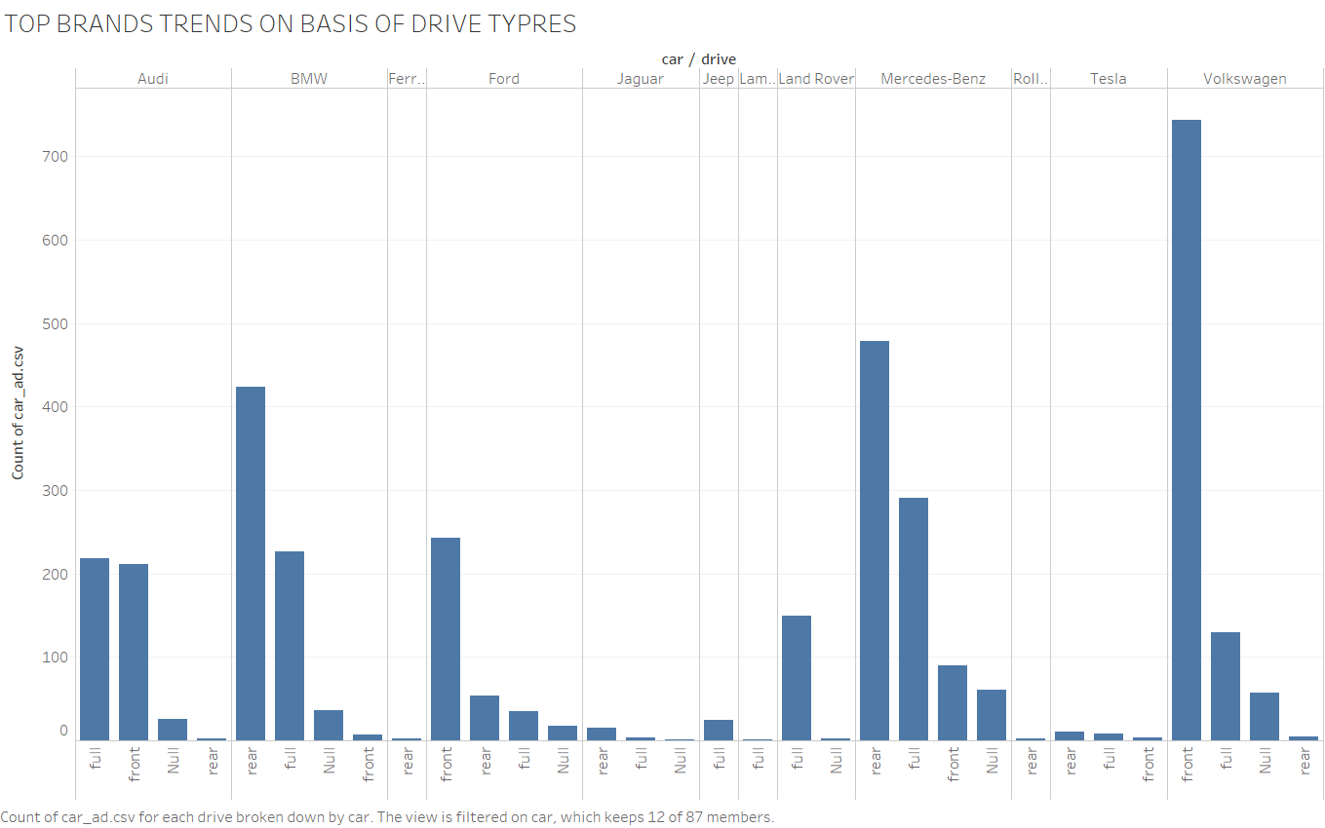

Slide 23
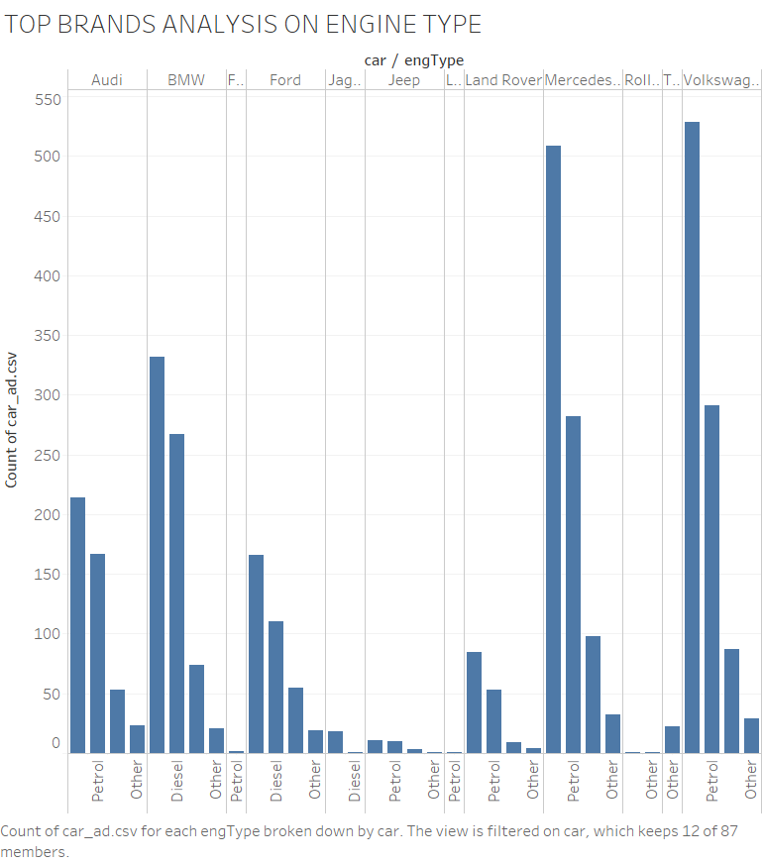

Slide 24
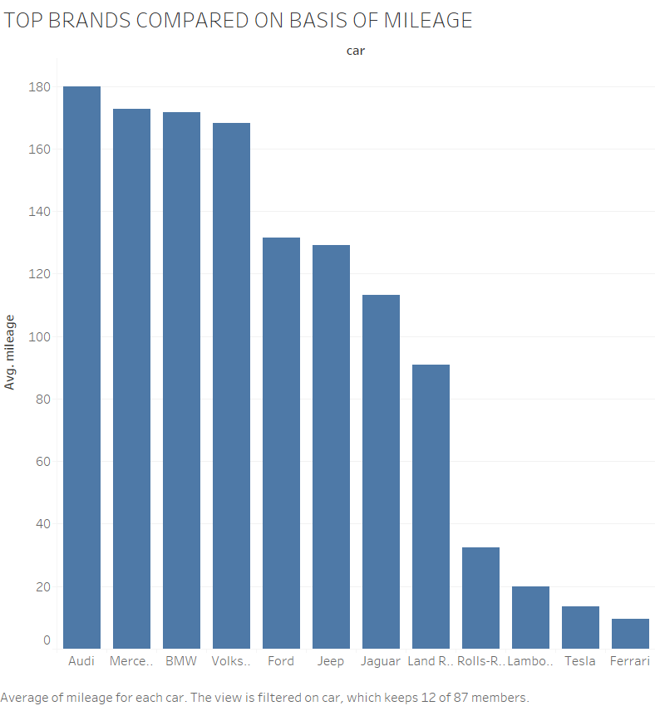

Slide 25
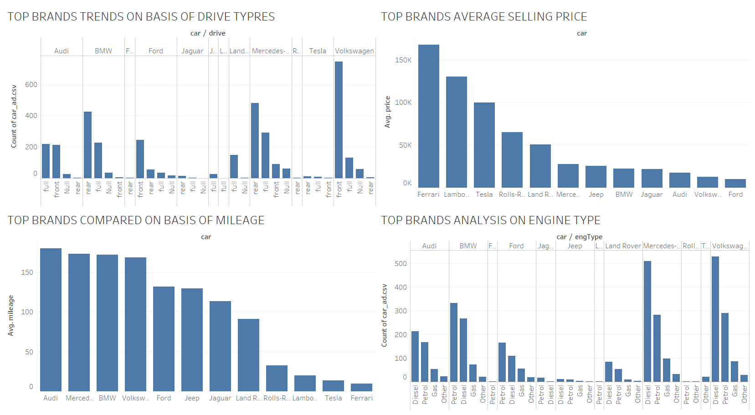

Slide 26
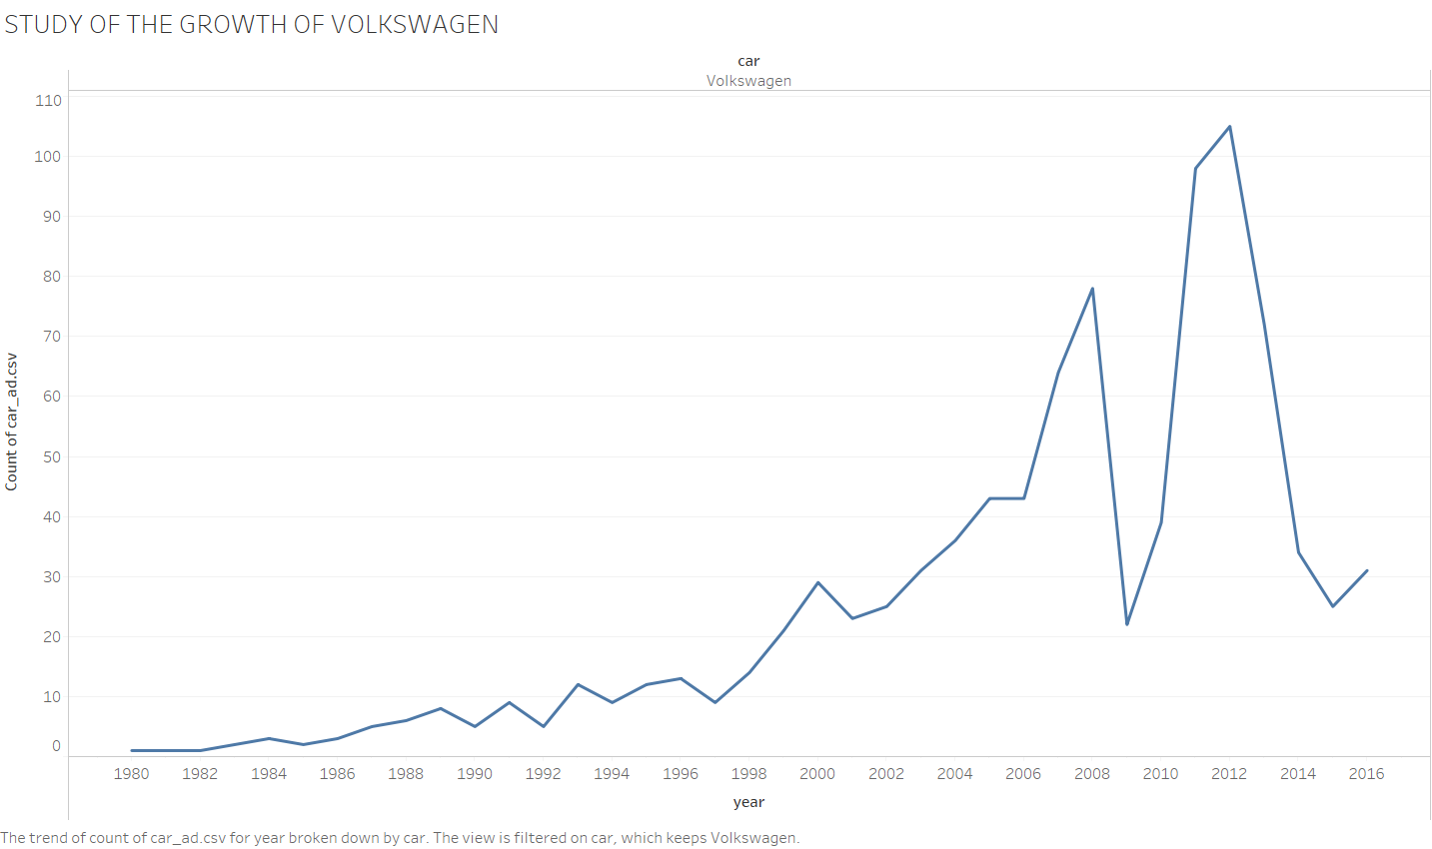

Slide 27
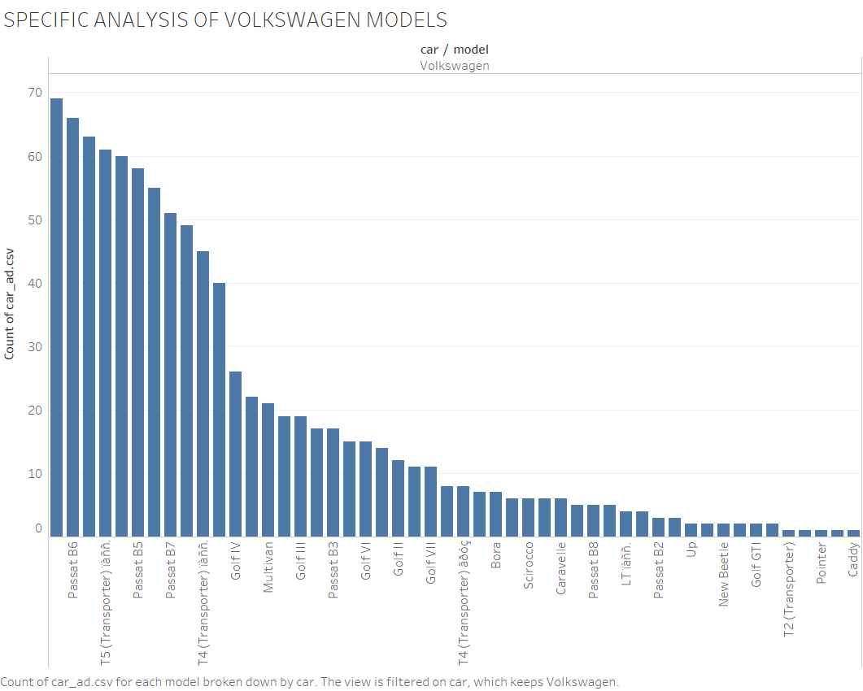

Slide 28
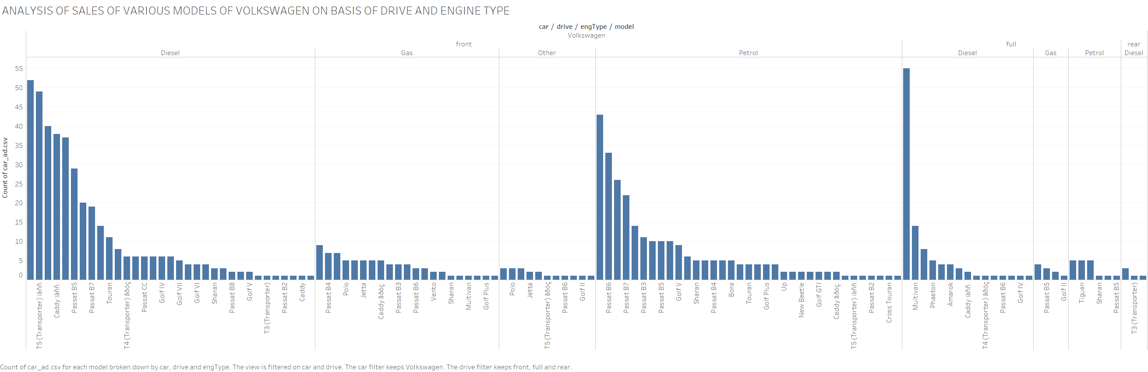

Slide 29
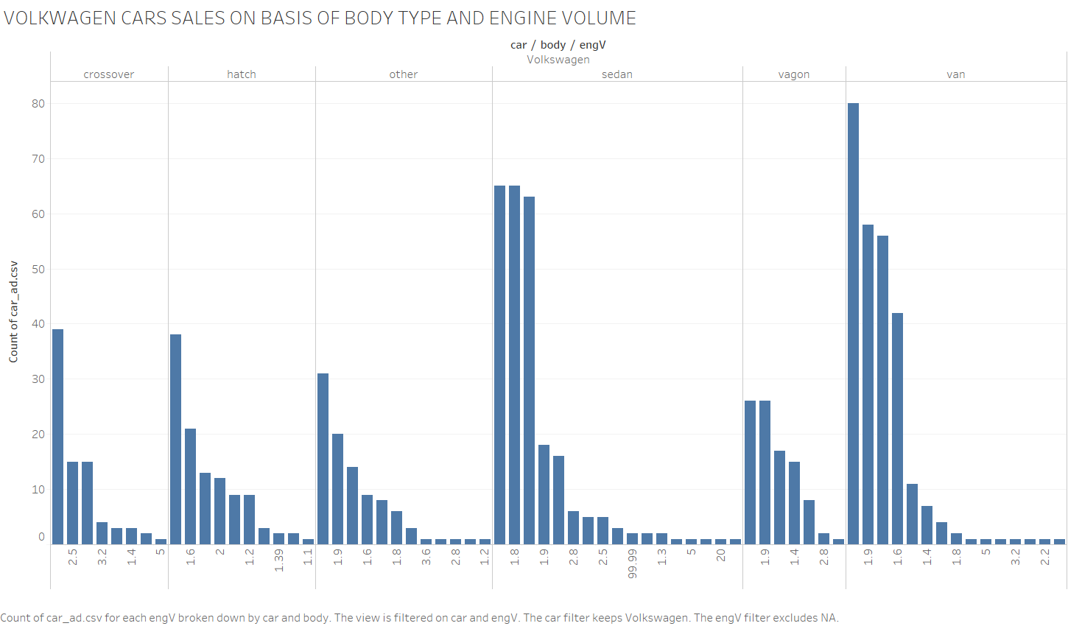

Slide 30
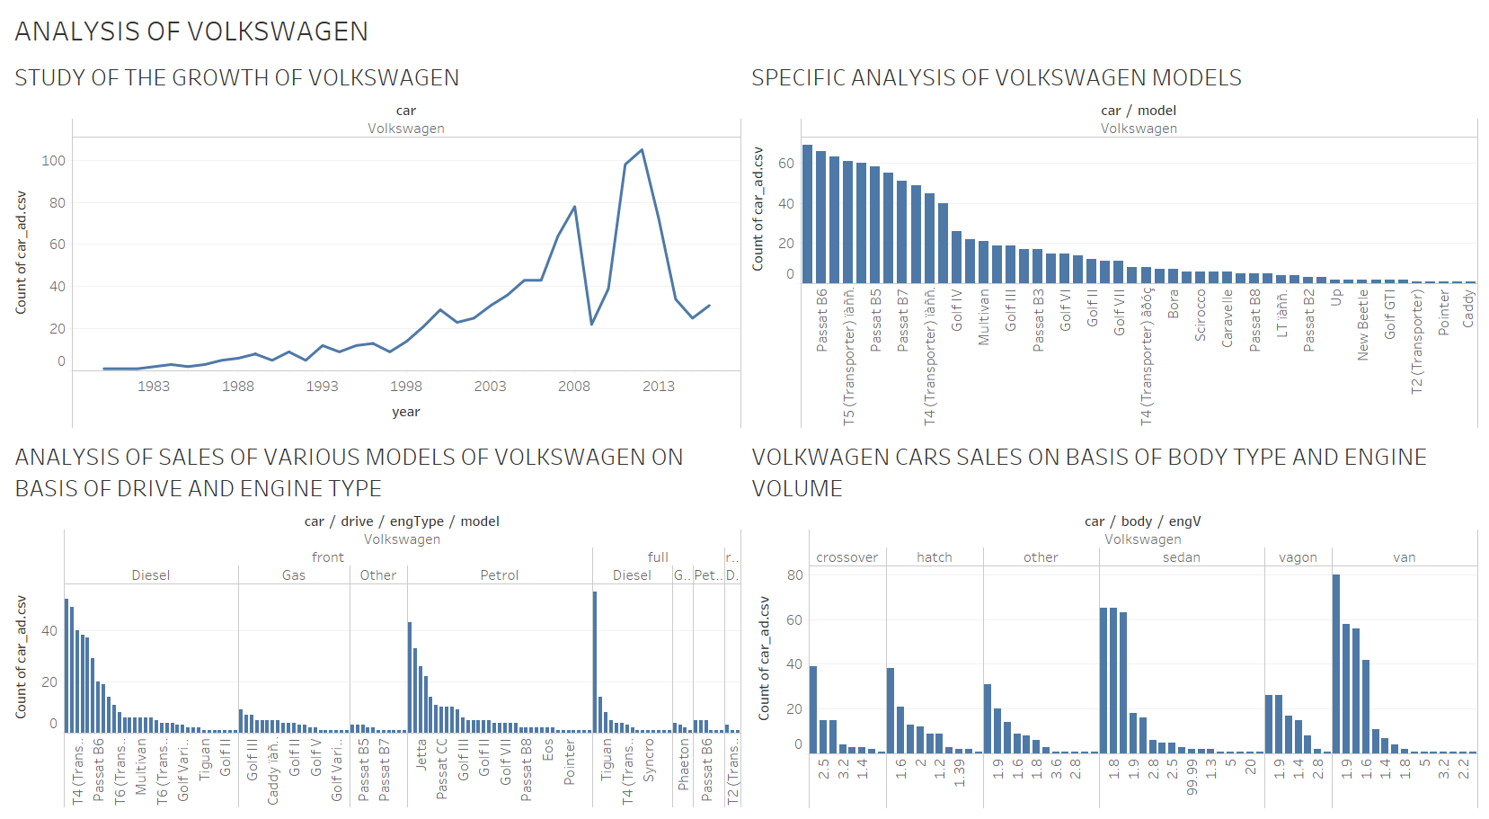

Slide 31
Future:
We want to extend this project further by visualizing the dataset more with seaborn , altire .
Then, we want to apply supervised and unsupervised machine learning techniques to predict the price range of the car.
We also want to cluster the companies into tiers top, middle ,low.
Finally, a GUI for predicting the range.

